Slide 1
Azure BeerOps

Slide 2
Attention
MMS sessions are 60-75 minutes followed by LONG Q&A
Please hold detailed questions until that Q&A starts
Feel free to ask clarification questions
Remind the speakers to use Zoom It when you can’t see

Slide 3

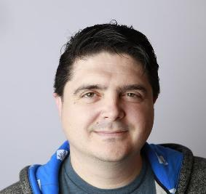


Scott Corio
Donnie Taylor
Microsoft MVP, Brewer
Microsoft MVP, Sorta-Brewer
dumpsterdave
in/scottcorio
donnietaylor
in/donnietaylor

Slide 4
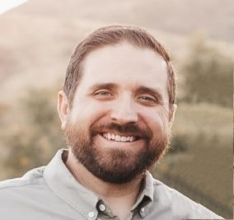
Nathan Ziehnert
Microsoft MVP, Destroyer of Kegerators
theznerd
in/nathanziehnert

Slide 5
Know Before You Show (up to our session)
We assume that you will have a strong grasp on the following concepts:
Beer > Water
Azure > On-Prem > AWS
It will help (but is not required) to understand:
APIs (Alcohol Production & Ingestion)
REST APIs (APIs while you sleep)
DNS (Donuts, Not Strudels)
KQL (Keg Query Language)
Postman (The one with Kevin Costner)
Raspberry Pi (When you can’t get apple or cherry)

Slide 6
What is Beer?
Beer is a fermented beverage made from malted cereal grains and yeast.
Beer can traditional
Ale – Top fermenting yeast (Saccharomyces cerevisiae)
Lager – Bottom fermenting yeast (Saccharomyces pastorianus)
Temperature doesn't matter
Beer can be the start Bourbon/Whiskey/Scotch
With "Beer", the grains are separated from the wort before fermenting
With Whiskey, the grains are fermented along with the wort

Slide 7
How Do We Make Beer?
Water + Malted Barley + Hops + Yeast = Beer
Hot water is mixed with crushed grain which converts the starches into fermentable sugars
The wort is drained and then boiled with hops to extract the oils, alpha acids, concentrate the sugars, and boil off DMS
Wort is then chilled and yeast added which converts the sugar to alcohol
Yeast eats sugar, poops alcohol, and farts carbon dioxide
Enjoy your yeast poop!

Slide 8
So What Does Azure Have to do With Beer?
Absolutely Nothing!
But for the purposes of this demonstration…
Still Nothing

Slide 9
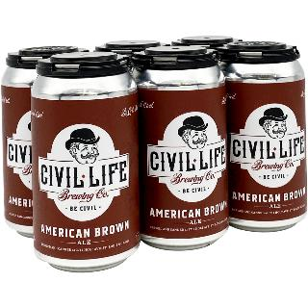
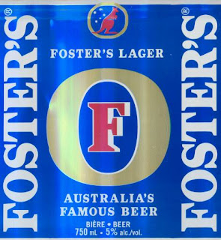
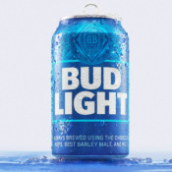
What is Beer?
Beer
Beer (Australia Only)
Not Beer
Anywhere

Slide 10
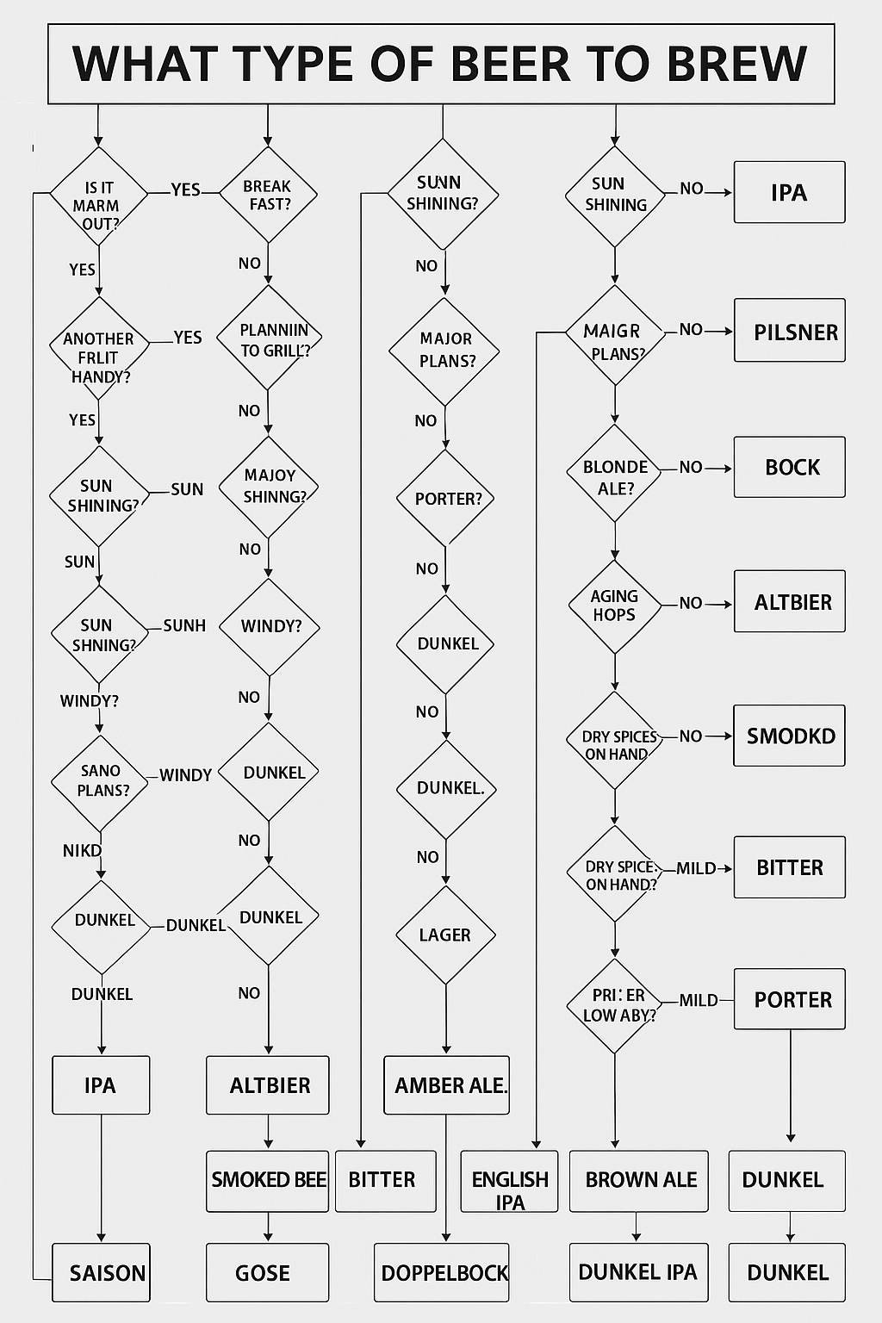
How do we know what to make?
Drinking beer is easy
Making it is as simple or as complicated as you want
You only have so many kegs or bottles – and only so much time

Slide 11
Your Choices
Make an IPA because you always make an IPA
Ask that crazy friend who once suggested adding cheese and mushrooms
Doesn’t matter as long as its ABV is above 12
Give up and drink Bud Light
Give up and ask a generic AI (see previous slide)
Train your own AI with 75000+ beer recipies – cause if it’s worth doing, it worth f’ing up with unnecessary technology
(Which is why my chicken coop has wifi)

Slide 12
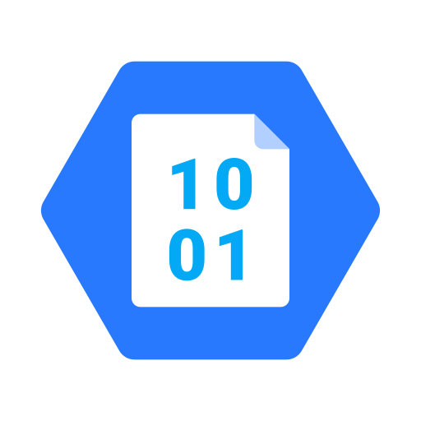
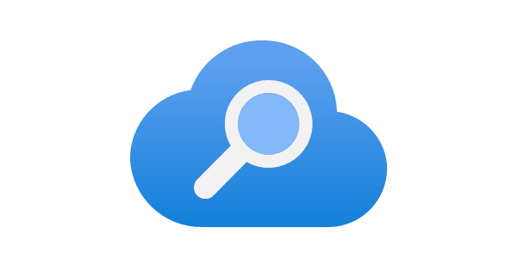
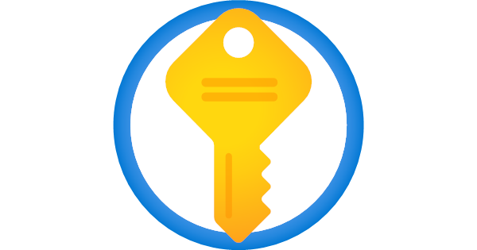
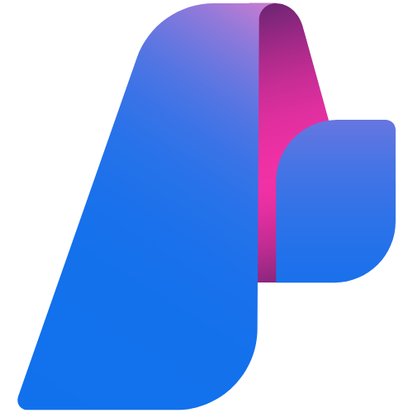



I don’t want to make decisions
Azure Subscription and Resource Group
Key Vault – for your keys
Storage Account
AI Search Service
Azure AI Hub
Azure AI Foundry – deploy everything with no code
Azure AI Project
gpt-4o and ada-002
“You know what you are doing”
Brewingfordummies.ai

Slide 13
A quick word about Prompts
Don’t forget the persona and sample output!
“You are an expert at brewing beer and recommending the appropriate recipe to fellow brewers…….”
“Your output should include: Recipe Name: <name> ABV: <abv> Link to recipe: <link>”
Zero-Shot
One-Shot
Few-Shot
Describe the types of AI
Describe the types of AI prompts like Zero-Shot
Describe the types of AI prompts like Zero-Shot and One-Shot
Chain of Thought
Describe the types of AI prompts like Zero-Shot and One-Shot
<output from the LLM>
Describe the benefits of One-Shot over Few-Shot and why I would use either.

Slide 14
Bad Decisions
But at least you didn’t make them

Slide 15
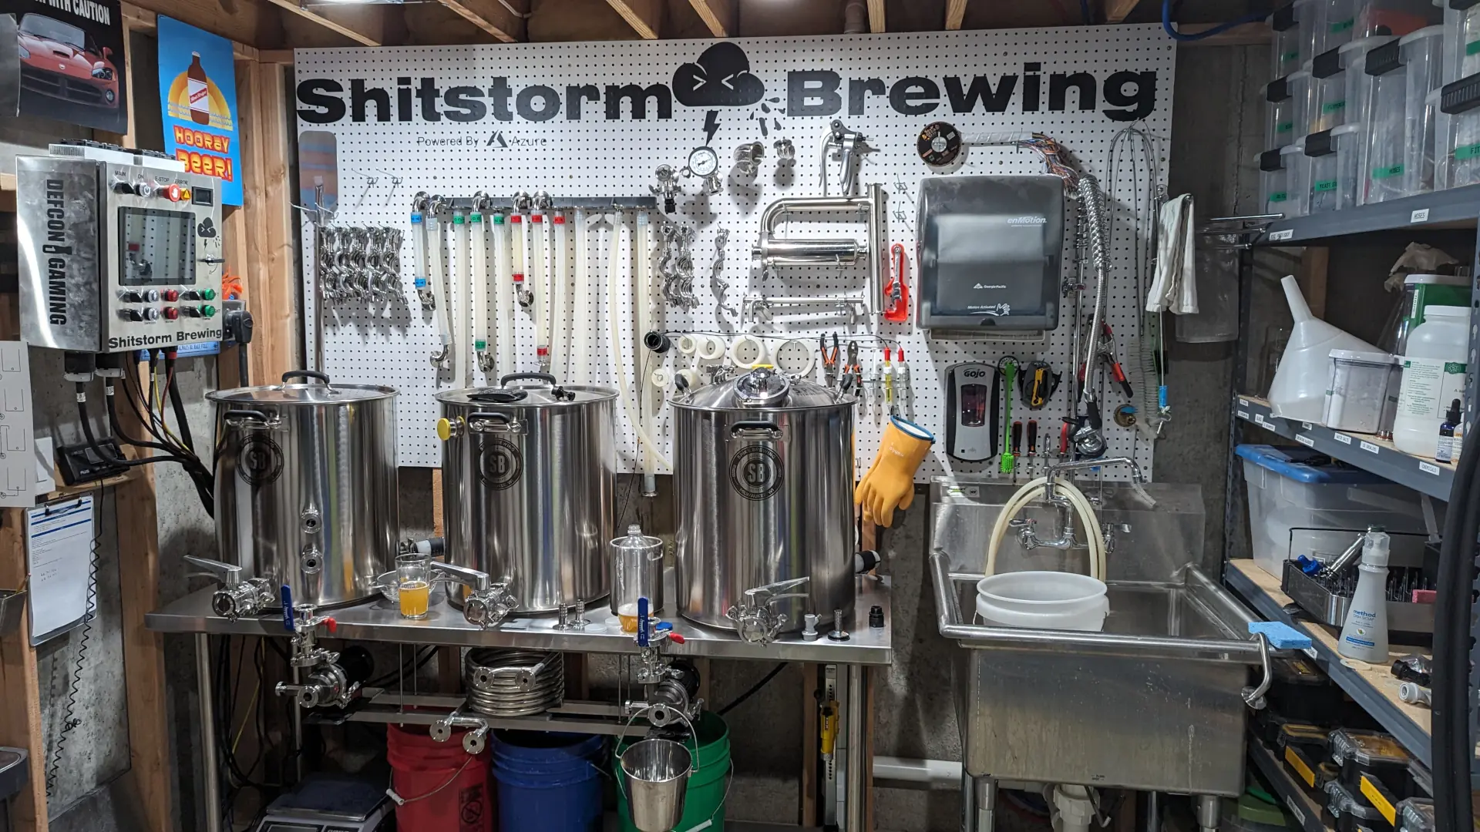
How do we brew beer with Azure?

Slide 16
Azure Alcohol Production/Ingestion (API)
How do we track our liver failure with Azure?
Ingestion API (REST)
IoT Hub
Service Bus
Event Hub
Logic App
Which one do we pick?

Slide 17
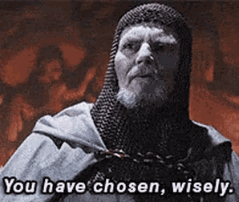
Options, Options, Options
Ingestion API
Direct (Fastest)
Cheapest
Data direct to single endpoint only (Log Analytics)
DCR Capable
IoT Hub/Service Bus
Third Fastest
Bi-directional Communication (Can be useful if we want to react to data changes)
Can be in-expensive
Event Hub
Second Fastest (Barely slower than Ingestion API)
Most Expensive Option (out of those listed)
Can send data to multiple endpoints
DCR Capable
Logic App
Slowest (requires either something to cache the data, or low data rates)
Full ETL (Extract/Transform/Load)
Can be the most expensive depending on options

Slide 18
Making Beer – Using the API
Read Sensors
Update Data Structure
Conver to JSON Payload
Get or Update Credential (Certificate)
Send Payload
Transform/Load Data

Slide 19
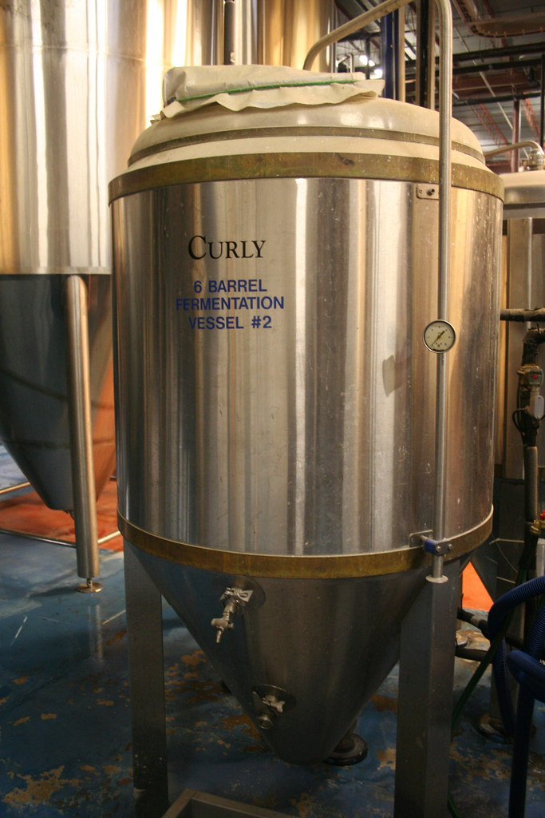

For the Brewery:
REST API
This Photo by Unknown Author is licensed under CC BY-NC-ND

Slide 20
So What Does Azure Have to do With Beer?
Absolutely Nothing!
But for the purposes of this demonstration…
Still Nothing. Really, it won't cost anything!

Slide 21
Using the Log Analytics Ingestion API

Slide 22
What about Fermenting?
Fermenting is a longer process, with less data point changes
Slower change rate = less frequent data requirements
Might need Bi-Directional Communication
Change the fermentation temperature
Fermentation takes longer than brewing and we aren't always present for the whole process.

Slide 23



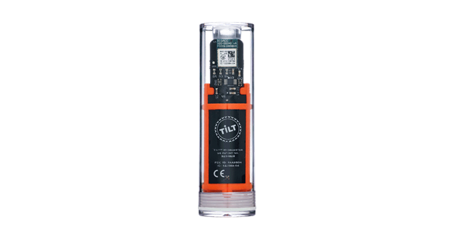




For the Fermenter
IoT Hub
Service Bus Queue
Logic App
Log Analytics
PowerBI
Raspberry Pi
Workbook

Slide 24
What does this cost?
IoT Hub
Free for up to 8,000 messages per day. Messages over 8,000 discarded on free tier.
1 message per 5 minutes = ~288 messages per day. Can do up to once per ~15sec for free.
Service Bus Queue
$0.05/million operations on Basic Tier
Logic App
First 4,000 actions/mo free, $0.001/execution after that
Log Analytics
First 5GB/Month Free, $2.76/GB/Mo after 5GB
Our estimated run price per month: $0.17
All prices above effective 2021-09-15 in East US Region in $USD.

Slide 25
FaaS
Fermentation as a Service

Slide 26


All of you heathens…

Slide 27
Vibe Coding and Azure Web Apps
Not a developer? Not a problem.
We’re not coding from experience… just pure vibes

Slide 28
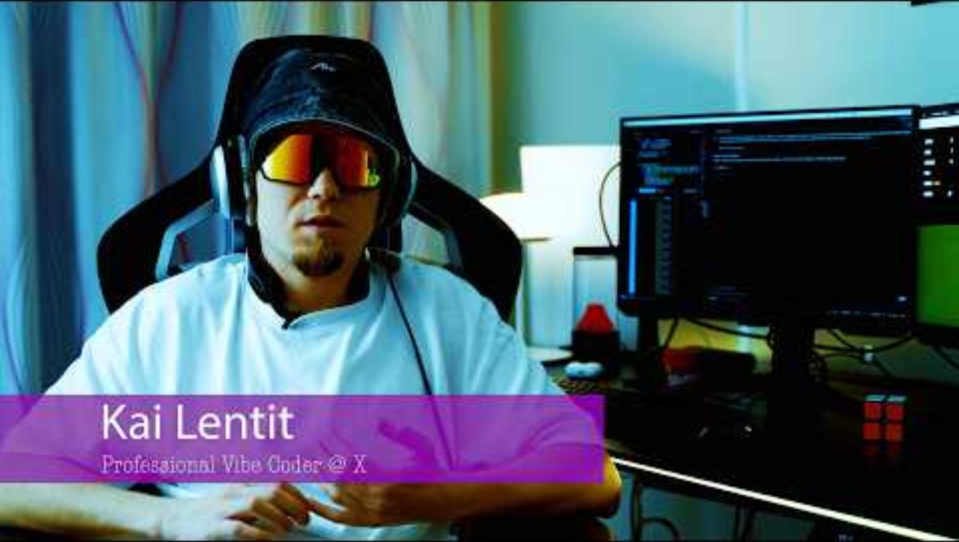

Slide 29
Vibe Coding Tools
VSCode and Copilot Subscription
Cursor
Replit
Bolt.new
Loveable.dev
Probably about 7 dozen more by the time this presentation is given…

Slide 30
Blood Alcohol Content Estimator
Going hard in the paint at MMS?
Uses a very special equation:
(Dose in grams/(Body weight in grams x Distribution ratio "r"))x100 where r(male)=.68 r(female)=.55 and assuming an average constant rate of -0.016 BAC per hour.
45-minute delay for each beverage
Gives you an estimate until you’re sober
Written entirely off vibes alone…
https://mms2025-bac-dev.azurewebsites.net/
Notes:
On average it takes 30-70 minutes for alcohol to reach your bloodstream

Slide 31
Which Model?!
My favorite: Claude 3.7 (when not hampered)
My least favorite: Thinking models
Pick the right tool for the job
Thinking models – possibly better at troubleshooting
Models with HUGE context windows – can process more of your codebase
Claude (at the time of creating this presentation) handles most code well

Slide 32
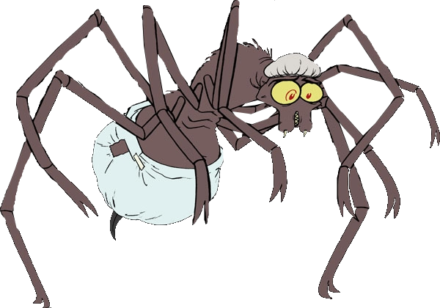
What About MCPs?
MC Pee Pants?
Model Context Protocol
GitHub integration
Jira
Kubernetes
So much more…
For Cursor but can be used in many platforms): https://cursor.directory/mcp

Slide 33


What’s Our Pipeline
Launch VSCode
GitHub actions builds immediately without any tests
Yeet code straight into Azure Web App
Push direct to main – testing is for losers
Vibe chat with Copilot – no handwriting code, only vibes

Slide 34
Let’s add features based on straight vibes baby…
Maybe a chart? Maybe a way to save a drinking session locally? We’re going to go where the vibes take us…

Slide 35
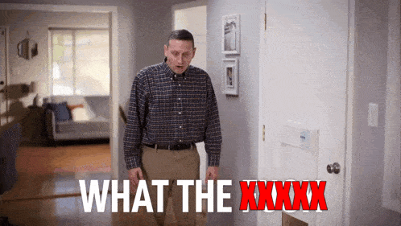
Vibe Coding Reality

Slide 36
All Jokes Aside
A fun way to bootstrap a new idea… BUT
You will spend a lot of time trying to correct problems…
The code can be mediocre – but you might not be aware…
Please, please, please, please, please, please – consider security in your application… work with someone if you don’t know where to start
Learn some basic coding principles (DRY / KISS / SOLID) and ask the model questions about code you don’t understand

Slide 37
Seeing as how this is the last session of the last day, if you didn't see Wally for a fishing session, then you really lost out. Seriously, fishing sessions are hands down one of the best aspects of MMS.
DON'T MISS OUT NEXT YEAR!!!!!
Find us at the bar tonight and we'll give you an impromptu fishing session

